Slide 1

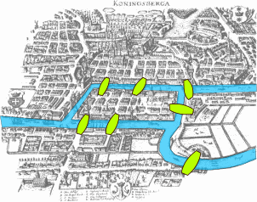
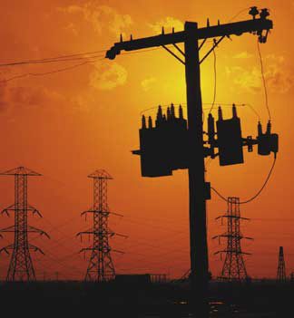
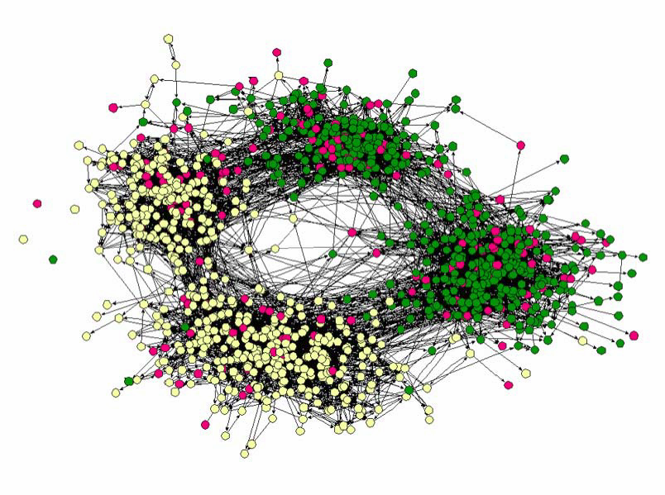
Complex networks: Basics

Slide 2
History of Graph Theory

Slide 3
Origins
1735: Euler was puzzled by solving the bridges of Königsberg (origins of graph theory)
1950: Erdős–Rényi was puzzled by the social networks structure
1969: Social Experiment: Milgram
1998: Stogratz, Watts: Small world network
1999: Barabási, Albert: puzzled by the Internet
Now: we are puzzled by all of them (brain, social networks, communication and transportation networks, etc)

Slide 4
The 7 bridges of Königsberg
C
A
D
B
The city of Königsberg, Germany, is divided by the Pregal River. The river forks and rejoins itself before forking off again.
4 land masses and 7 bridges

Slide 5
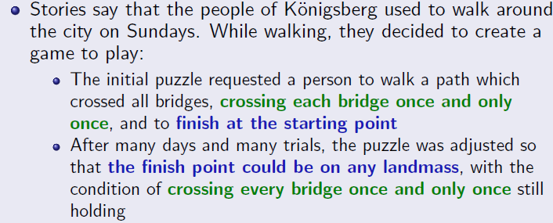
The 7 bridges of Königsberg
C
A
D
B

Slide 6
The 7 bridges of Königsberg
C
A
D
B

Slide 7
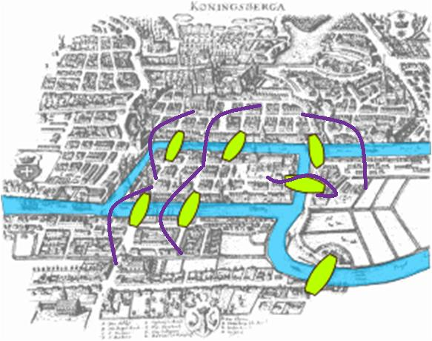
The 7 bridges of Königsberg
C
C->A->B->A->C->D->A???
A
D
B
4 land masses and 7 bridges
The question is whether it is possible to walk with a route that crosses each bridge exactly once?

Slide 8
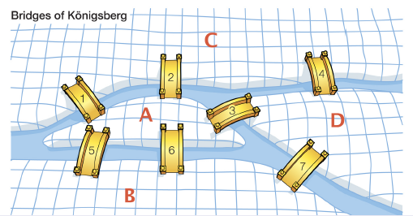
The 7 bridges of Königsberg
A-4 Edges; B-3 Edges
C-3 Edges; D-2 Edges

Slide 9
Complex networks: Outline
Mathematical representation of Networks: Adjacency matrix.
Types of Networks: Directed/Undirected/Weighted/Regular
Structural Characterization: Degree (in, out)
In-degree, Out-degree, application
Handshaking Lemma
Average Degree, Link Density
Walk, Trail, Path, Cycle, Shortest Path
Eulerian and Hamiltonian Graphs
Shortest Path, Diameter
BFS search

Slide 10
What is complex network?
A complex network is a graph (network) with non-trivial topological features—features that do not occur in simple networks such as lattices or random graphs. Observed in various real field connected with the elements of that field.
Three main tools have been used for the quantitative study of networks:
graph theory;
statistical and probability theory;
algebraic models.

Slide 11
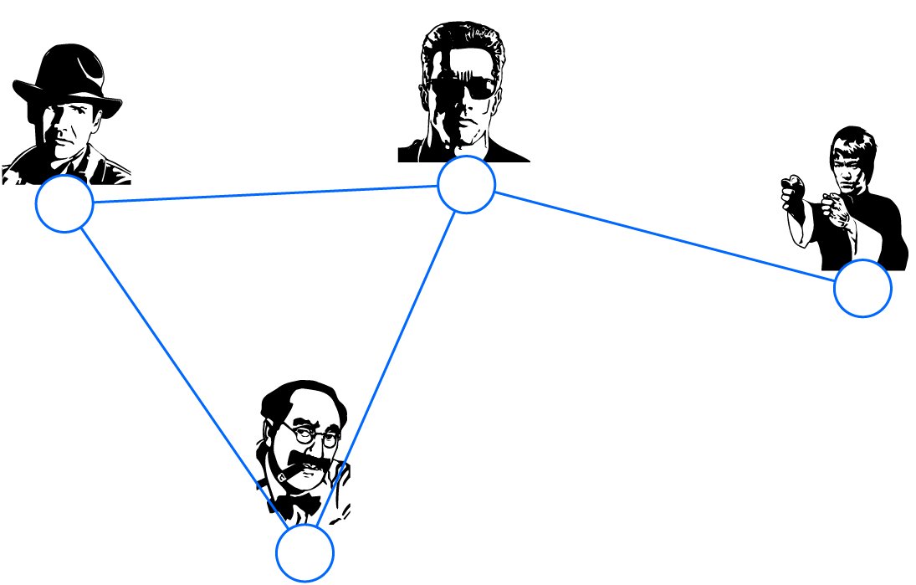

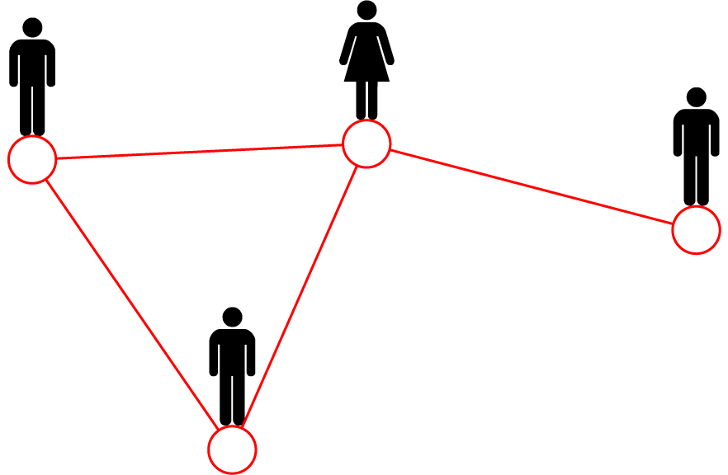
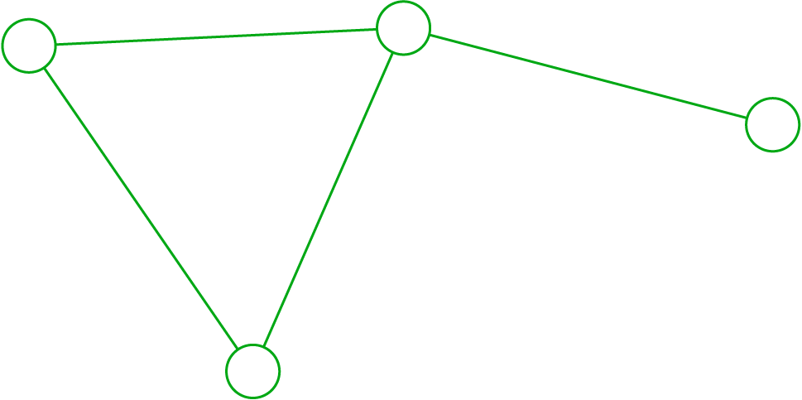
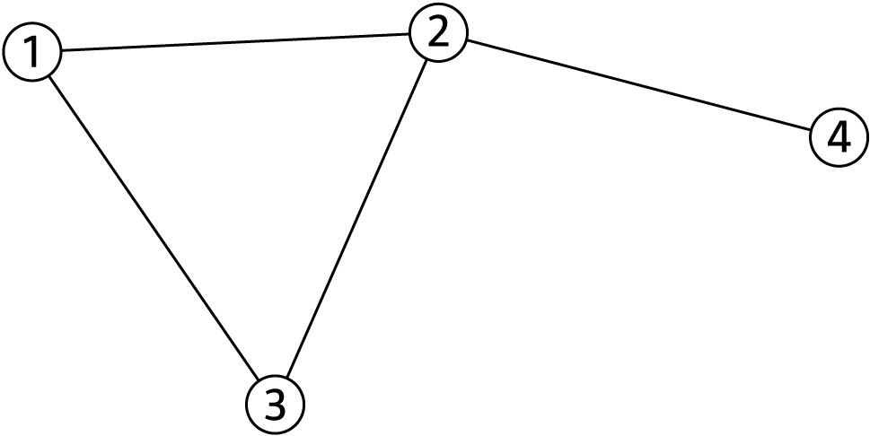
A common Language
friend
Movie 1
Mary
co-worker
Actor 2
Peter
Actor 1
Albert
Movie 3
Actor 4
brothers
friend
Movie 2
Albert
Actor 3
Protein 1
Protein 2
Protein 5
N=4
L=4
Protein 9
Barabasi_paper

Slide 12
CHOOSING A PROPER REPRESENTATION
The choice of the proper network representation determines our ability to use network theory successfully.
In some cases there is a unique, unambiguous representation.
In other cases, the representation is by no means unique.
For example,, the way we assign the links between a group of individuals will determine the nature of the question we can study.
Network Science: Graph Theory 2012

Slide 13
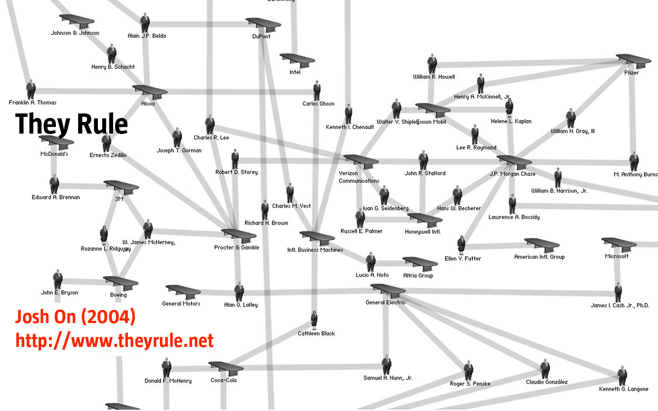
CHOOSING A PROPER REPRESENTATION
If you connect individuals that work with each other, you will explore
the professional network.
Network Science: Graph Theory 2012

Slide 14
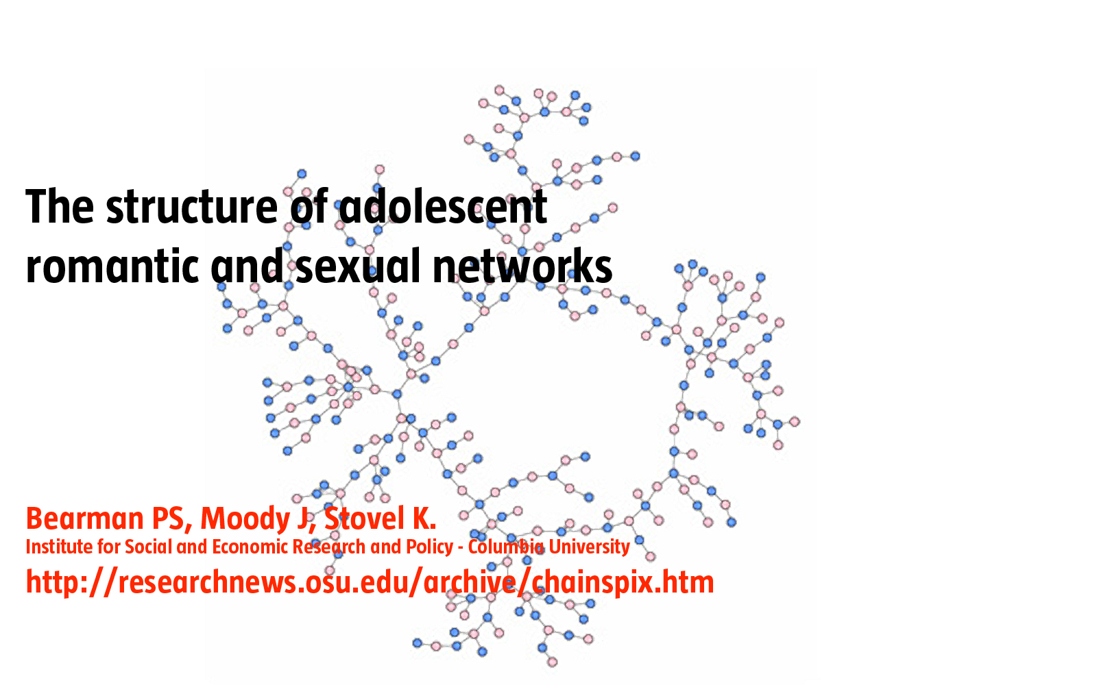
CHOOSING A PROPER REPRESENTATION
If you connect those that have a romantic and sexual relationship, you will be exploring the sexual networks.
Network Science: Graph Theory 2012

Slide 15
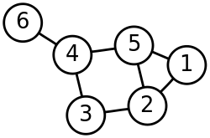
Simple Graph
Two vertices v and w are adjacent if there is an edge joining them and the vertices are said to be incident to such an edge,
The degree of a vertex v of G is the number of edges incident to v.
6 vertices and 7 nodes

Slide 16
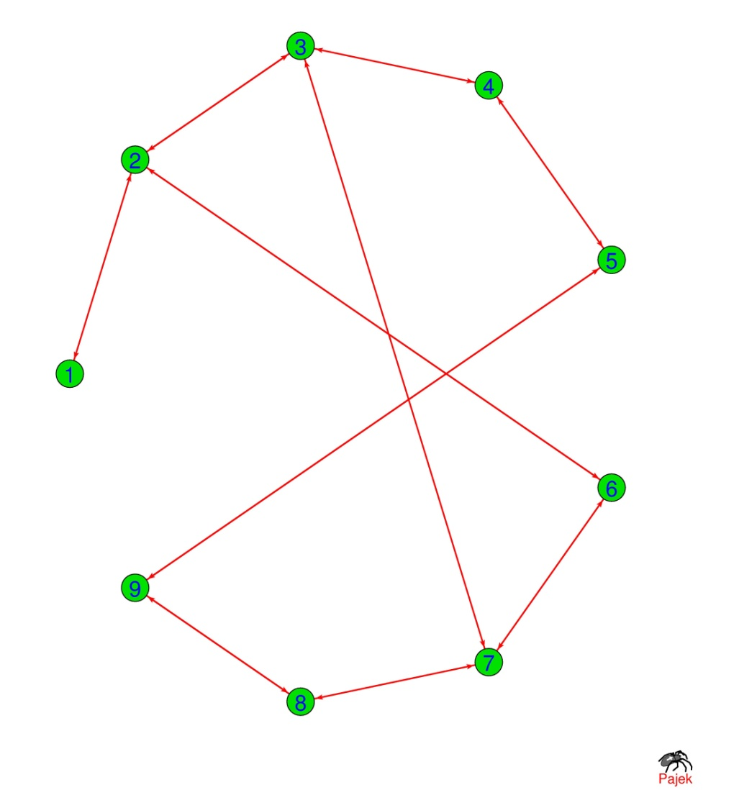
Adjacency matrix
1 2 3 4 5 6 7 8 9
0 1 0 0 0 0 0 0 0
1 0 1 0 0 1 0 0 0
0 1 0 1 0 0 1 0 0
0 0 1 0 1 0 0 0 0
0 0 0 1 0 0 0 0 1
0 1 0 0 0 0 1 0 0
0 0 1 0 0 1 0 1 0
0 0 0 0 0 0 1 0 1
0 0 0 0 1 0 0 1 0
1 2 3 4 5 6 7 8 9

Slide 17
Complex network
Directed
Undirected
Weighted
Regular Network

Slide 18
Complex network
Directed
Undirected
Weighted
Regular Network
Random Network
Small World Network
Scale-free network

Slide 19
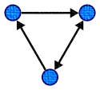
Directed and undirected network
Undirected: Edges have no orientation. The edge (a, b) is identical to the edge (b, a), i.e., they are not ordered pairs.
Directed: Set of nodes connected by edges, where the edges have a direction associated with them.

Slide 20

Degree (Structural Characterization)
In an undirected network the degree k_{i} of a node i is the number of nodes connected to $i$:
k_{i} = Σ_{j} a_{ij} = Σ_{j} a_{ji}

Slide 21
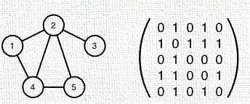
Degree (Structural Chracterization)
In an undirected network the degree k_{i} of a node i is the number of nodes connected to $i$:
k_{i} = Σ_{j} a_{ij} = Σ_{j} a_{ji}
Here k₁ = 2, k₂ = 4, k₃ = 1, k₄ = 3 and k₅ = 2.

Slide 22

In-Degree and Out-degree
In a directed network the in-degree k_{i}^{(in)} of a node i is the number of directed edges pointing to node i:
$$k_{i}^{in}=\sum_{j=1}^{N}{A_{ji}}$$

Slide 23

In-Degree and Out-degree
In a directed network the in-degree k_{i}^{(in)} of a node i is the number of directed edges pointing to node i:
while the out-degree k_{i}^{(out)} of a node i is the number of directed edges pointing from node i:
$$k_{i}^{in}=\sum_{j=1}^{N}{A_{ji}}$$
$$k_{i}^{out}=\sum_{j=1}^{N}{A_{ij}}$$

Slide 24
In-Degree and Out-degree
For directed networks the sums over the adjacency matrix’ rows and columns provide the incoming and outgoing degrees, respectively.
Given that in an undirected network the number of outgoing links equals the number of incoming links.

Slide 25
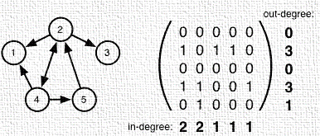
In-Degree and Out-degree
Thus, in a directed network, nodes can be highly connected, yet also isolated (e.g. in terms of sending or receiving information.)

Slide 26
In-Degree and Out-degree
Thus, in a directed network, nodes can be highly connected, yet also isolated (e.g. in terms of sending or receiving information.)

Slide 27
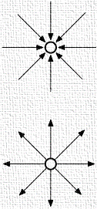
Citations
The network of scientific citations provide examples illustrating two extremes:
High in-degree and low out-degree:
much-cited research article

Slide 28
Citations
The network of scientific citations provide examples illustrating two extremes:
High in-degree and low out-degree:
much-cited research article
Low in-degree and high out-degree: Book

Slide 29
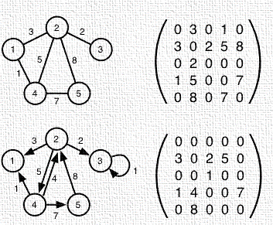
Weighted Networks
In a weighted network a real number is attached to each edge, so that we obtain a real adjacency matrix, usually denoted as w_{ij}.

Slide 30
Weighted Networks
In a weighted network a real number is attached to each edge, so that we obtain a real adjacency matrix, usually denoted as w_{ij}.

Slide 31

Handshaking lemma
If we add up the degrees of all vertices of a graph the result is an even number -> twice the number of edges.
for a graph with vertex set V and edge set E
Notes:
If the several people shake hands to each other then the total number of shaking hands will be even.

Slide 32
Handshaking lemma
If we add up the degrees of all vertices of a graph the result is an even number -> twice the number of edges.
for a graph with vertex set V and edge set E
Notes:
If the several people shake hands to each other then the total number of shaking hands will be even.

Slide 33
Handshaking lemma
If we add up the degrees of all vertices of a graph the result is an even number -> twice the number of edges.
for a graph with vertex set V and edge set E
The sum of the degrees of the vertices is 2 + 3 + 2 + 3 + 3 + 1 = 14, twice the number of edges.
Notes:
If the several people shake hands to each other then the total number of shaking hands will be even.

Slide 34
Mean Degree and Link/edge Density

Slide 35
Mean Degree and Link/edge Density
Undirected
j
i
N – the number of nodes in the graph
B
D
Directed
C
E
A
F
Network Science: Graph Theory 2012

Slide 36
Walk, Trail, Path, Cycle, Shortest Path
Notes:
Any two consecutive edges are either adjacent or identical. The number of edges in a walk is called its length.

Slide 37
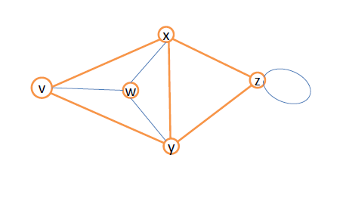
Walk, Trail, Path, Cycle
Walk: any route through a graph from vertex to vertex along edges
Trail: A trail is a walk that does not pass over the same edge twice. A trail might visit the same vertex twice, but only if it comes and goes from a different edge each time.
Trail: v->w->x->y->z->z->x
Notes:
Any two consecutive edges are either adjacent or identical. The number of edges in a walk is called its length.

Slide 38
Walk, Trail, Path, Cycle
Walk: any route through a graph from vertex to vertex along edges
Trail: A trail is a walk that does not pass over the same edge twice. A trail might visit the same vertex twice, but only if it comes and goes from a different edge each time.
Path: A path is a walk that does not include any vertex twice, except that its first vertex might be the same as its last.
Trail: v->w->x->y->z->z->x
Path: v->w->x->y->z
Closed Trail: v->w->x->y->z->x->v
Notes:
Any two consecutive edges are either adjacent or identical. The number of edges in a walk is called its length.

Slide 39
Walk, Trail, Path, Cycle
Walk: any route through a graph from vertex to vertex along edges
Trail: A trail is a walk that does not pass over the same edge twice. A trail might visit the same vertex twice, but only if it comes and goes from a different edge each time.
Path: A path is a special type of walk that does not include any vertex twice, except that its first vertex might be the same as its last.
A cycle is a path that begins and ends on the same vertex. A circuit is a trail that begins and ends on the same vertex.
Trail: v->w->x->y->z->z->x
Path: v->w->x->y->z
Closed Trail: v->w->x->y->z->x->v
Circuit: v->w->x->y->v
Triangle: v->w->x->v
https://www.monash.edu/student-academic-success/mathematics/graphs-and-networks/walks,-trails,-paths,-cycles-and-circuits
Notes:
Any two consecutive edges are either adjacent or identical. The number of edges in a walk is called its length.

Slide 40
Eulerian and Hamiltonian Graph
A connected graph is Eulerian circuit if there exists a circuit using every edge exactly once.
It is Hamiltonian circuit if there exists a circuit including every vertex exactly once.

Slide 41
Eulerian and Hamiltonian Graph
A connected graph is Eulerian circuit if there exists a circuit using every edge exactly once.
It is Hamiltonian circuit if there exists a circuit including every vertex exactly once.
A graph is said to be Eulerian if it contains at least one Eulerian circuit, or semi-Eulerian if it contains at least one Eulerian trail.

Slide 42

Eulerian and Hamiltonian Graph
Eulerian Trail
1
2
5
3
4
A path that traverses each link exactly once.
Network Science: Graph Theory 2012

Slide 43
Eulerian and Hamiltonian Graph
Eulerian Trail
Hamiltonian Path
1
1
2
5
2
5
3
4
3
4
A path that visits each node exactly once.
A path that traverses each link exactly once.
Network Science: Graph Theory 2012

Slide 44
Eulerian trail
using every edge exactly once

Slide 45
Eulerian trail
Eulerian trail: BBADCDEBC
using every edge exactly once

Slide 46
Eulerian circuit
using every edge exactly once

Slide 47
Is it possible to determine whether a graph has an Eulerian trail or an Eulerian circuit, without necessarily having to find one explicitly?

Slide 48
The criterion for Eulerian trail
trail

Slide 49
The criterion for Eulerian trail
trail

Slide 50
The criterion for Eulerian trail
trail

Slide 51
The criterion for Eulerian trails

Slide 52
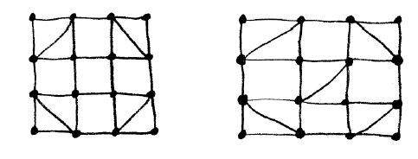
A connected graph G is Eulerian (circuit) if and only if the degree of every vertex of G is even.

Slide 53
A connected graph is Eulerian (trail) but not Eulerian if and only if it has exactly two vertices of odd degree.
A connected graph G is Eulerian (circuit) if and only if the degree of every vertex of G is even.

Slide 54
trail?

Slide 55
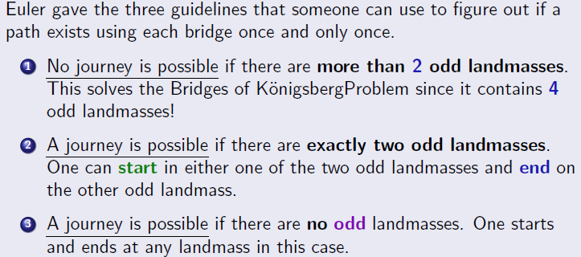
The 7 bridges of Königsberg
A-5 Edges; B-3 Edges
C-3 Edges; D-3 Edges

Slide 56
A-4 Edges; B-3 Edges
C-3 Edges; D-2 Edges
Guideline No:2

Slide 57
trail
How to find Eulerian trail or circuit?

Slide 58
How to find Eulerian trail

Slide 59
How to find Eulerian trail
trail

Slide 61
Query: It doesn’t matter which bridge you start at, or which direction you go in, the walk will bring you back to where you started.

Slide 63
45 bridges, 45km, 1,000 years of history
Bristol has 45 bridges that span the main waterways of the city which can be crossed on foot. Is it possible to walk across all of them without crossing the same bridge twice? This is the question posed by the 300-year-old ‘Konigsberg Bridge’ problem in mathematics, so-called because it was first asked in the city of Konigsberg around the year 1700. Such a walk is not always possible but for Bristol the answer is, currently, yes!
A route for Bristol’s walkable bridges was first devised in 2013 by Dr Thilo Gross, a former Reader in the Department of Engineering Mathematics of Bristol University.
It was published in the Bristol Post in February 2013 and then later that year in the Civic Society’s Better Bristol magazine in an article written by longstanding Society member Jeff Lucas.
https://www.bristolcivicsociety.org.uk/explore-bristol/bristol-bridges-walk/
https://reallygross.de/ops/bridgewalk

Slide 65
Path Length (Structural Characterization)
Physical distance vs Network Distance
Physical distance plays a key role in determining the interactions between the components of physical systems.
For example, the distance between two atoms in a crystal or between two galaxies in the universe determines the forces that act between them.

Slide 66
Path Length (Structural Characterization)
Physical distance vs Network Distance
Physical distance plays a key role in determining the interactions between the components of physical systems.
For example, the distance between two atoms in a crystal or between two galaxies in the universe determines the forces that act between them.
In networks distance is a challenging concept. Indeed, what is the distance between two webpages, or between two individuals who do not know each other? The physical distance is not relevant here

Slide 67
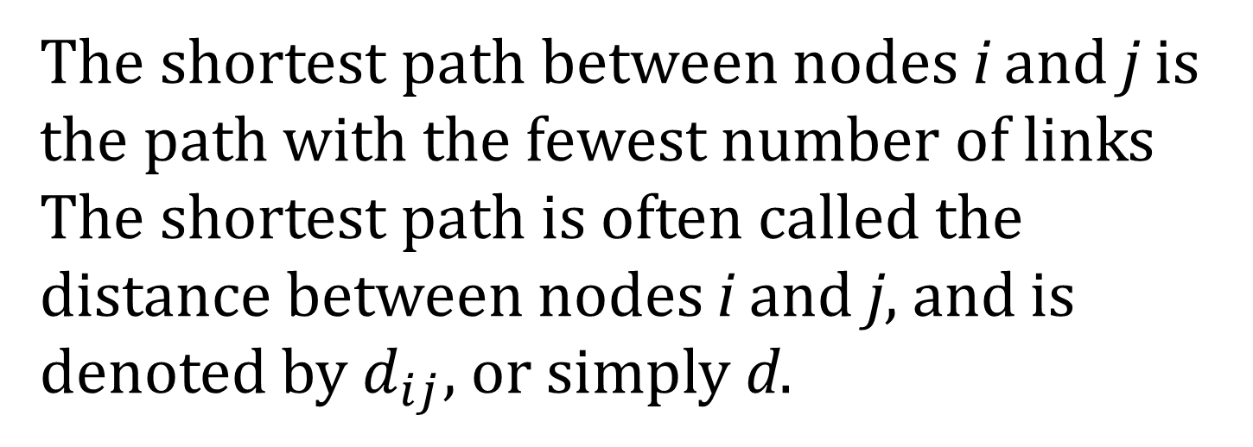
Shortest Paths
The shortest path between nodes i and j is the path with the fewest number of links The shortest path is often called the distance between nodes i and j, and is denoted by $d_{ij}$, or simply d.

Slide 68
DISTANCE IN A GRAPH Shortest Path, Geodesic Path
The distance (shortest path, geodesic path) between two nodes is defined as the number of edges along the shortest path connecting them.
*If the two nodes are disconnected, the distance is infinity.
In directed graphs each path needs to follow the direction of the arrows.
Thus in a digraph the distance from node A to B (on an AB path) is generally different from the distance from node B to A (on a BCA path).
B
A
D
C
B
A
D
C
Network Science: Graph Theory 2012

Slide 69
Adjacency matrix
1 2 3 4 5 6 7 8 9
0 1 0 0 0 0 0 0 0
1 0 1 0 0 1 0 0 0
0 1 0 1 0 0 1 0 0
0 0 1 0 1 0 0 0 0
0 0 0 1 0 0 0 0 1
0 1 0 0 0 0 1 0 0
0 0 1 0 0 1 0 1 0
0 0 0 0 0 0 1 0 1
0 0 0 0 1 0 0 1 0
1 2 3 4 5 6 7 8 9
MatLab script

Slide 70
Diameter, Average Pathlength

Slide 71
Diameter, Average Pathlength

Slide 72
Shortest Path : Additional notes

Slide 73
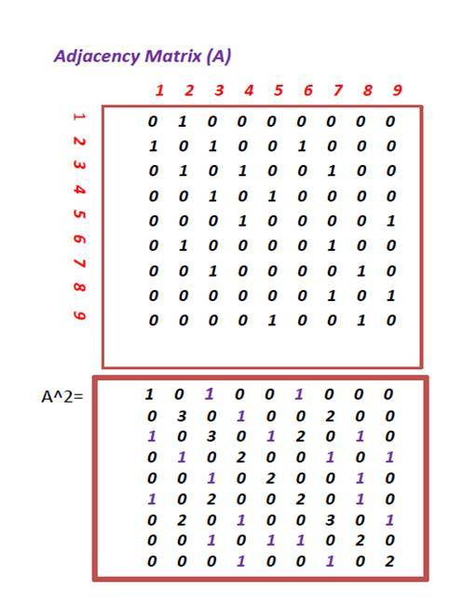
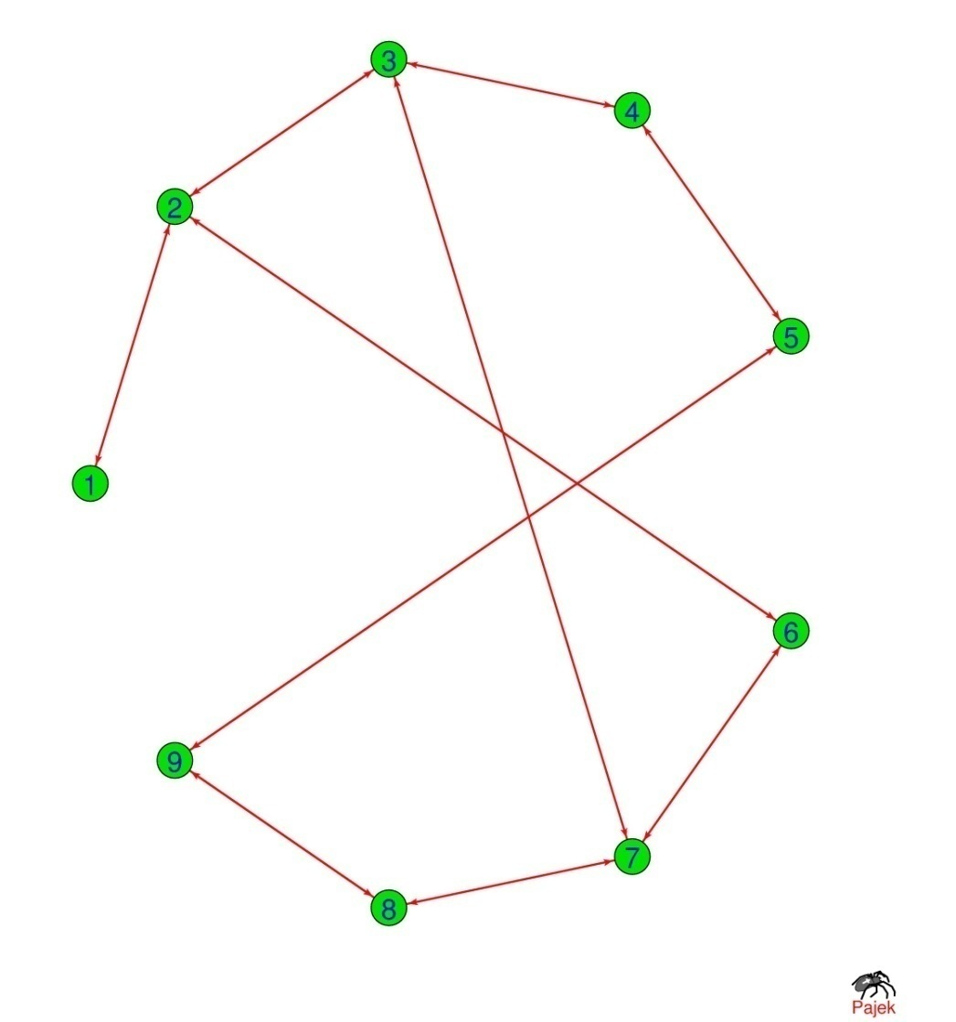
Shortest Path

Slide 74







Shortest Path

Slide 75






Shortest Path

Slide 76
BREADTH-FIRST SEARCH (BFS) ALGORITHM
MatLab script

Slide 77
BREADTH-FIRST SEARCH (BFS) ALGORITHM

Slide 78
Connected and Disconnected Components

Slide 79
Task 1-2
Construct your own random graph (N=10,50,500).
Symmetric?
Plot
Calculate all the pathlengths
Extract relevant information from the power of the matrix
Find the diameter
Plot the Histogram of all pathlengths
Calculate all centralities (degree, closeness, betweenness etc)
Check Eulerian trail / circuit (small size grah)

Slide 80
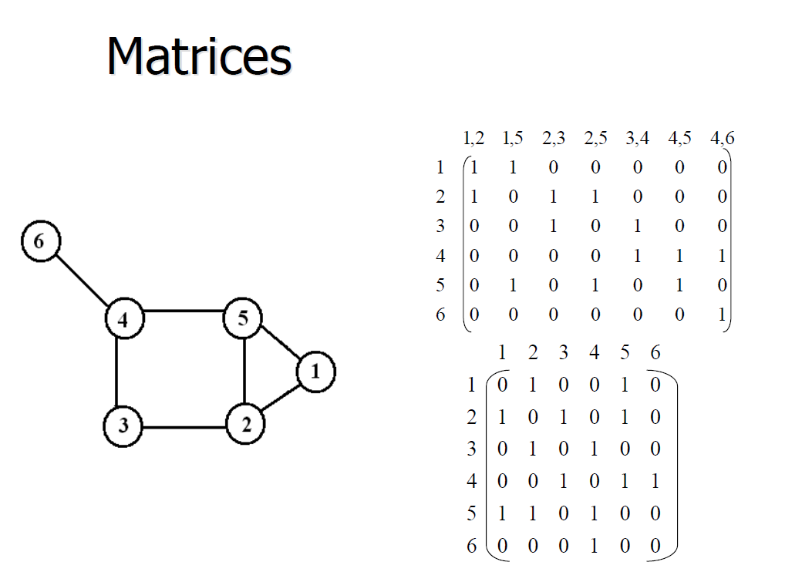
Edge list and node list

Slide 81
Edge list and node list

Slide 82
Edge list and node list

Slide 83
Complement, Connected and disconnected
If G be a simple graph with vertex set V(G); The complement G of G is the simple graph which has V(G) at its vertex set and in which two vertices are adjacent if and only if they are not adjacent in V(G).
Given any pair of vertices v,w of Graph G there is a path from v to w : Connected graph
An arbitrary graph can split up into disjoint connected
subgraphs called components.

